Slide 1
Online Notes
The Online Notes project is a web-based application developed using Java, MySQL, JDBC, Servlet, JSP, HTML, and CSS. It allows users to manage their notes efficiently. The project includes:
Login and Signup Page: Secure user authentication system for new and returning users.
Home Page: A dashboard where users can add new notes with titles and descriptions.
Show Notes Page: Displays all the saved notes, with options to update or delete them. Users can view the content and make necessary changes to their notes.
The application uses MySQL as the database for storing user and note data, while JDBC connects the front-end to the back-end logic. The project is structured with a clean user interface, incorporating HTML and CSS for seamless navigation and interaction.

Slide 2
How to run:
Set Up Prerequisites: Install JDK, Apache Tomcat, MySQL, and an IDE like Eclipse or IntelliJ IDEA to develop and run the project.
Database Configuration: Create a MySQL database (e.g., notes_db), and either import the provided SQL file or manually create the required tables (users and notes).
Update Project Settings: Open the project in your IDE and configure the database connection settings in the relevant file (e.g., DBConnection.java) with your MySQL URL, username, and password.
Build and Deploy: Compile the project in your IDE, generate a .war file, and deploy it in the webapps folder of the Tomcat server. Start the server.
Run the Application: Open your web browser, go to http://localhost:8080/OnlineNotes (or your project name), sign up for an account, and start managing your notes.

Slide 3
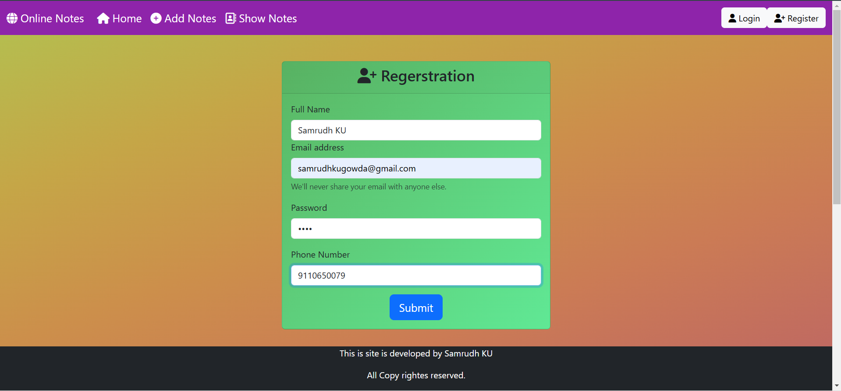
Regerstration Page: Hear we can resgister to the Web Application.

Slide 4
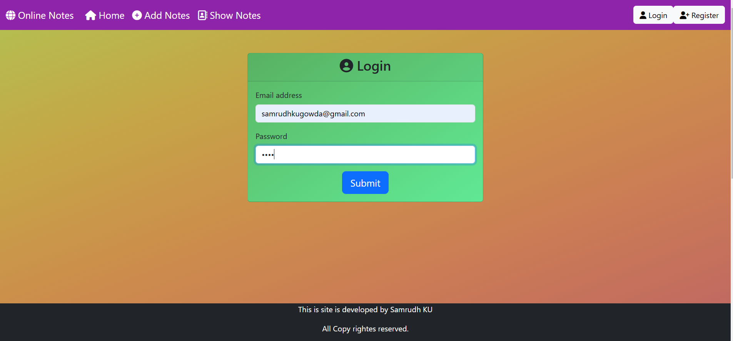
Login Page: Hear we can login to Web Application using Email address and password.

Slide 5
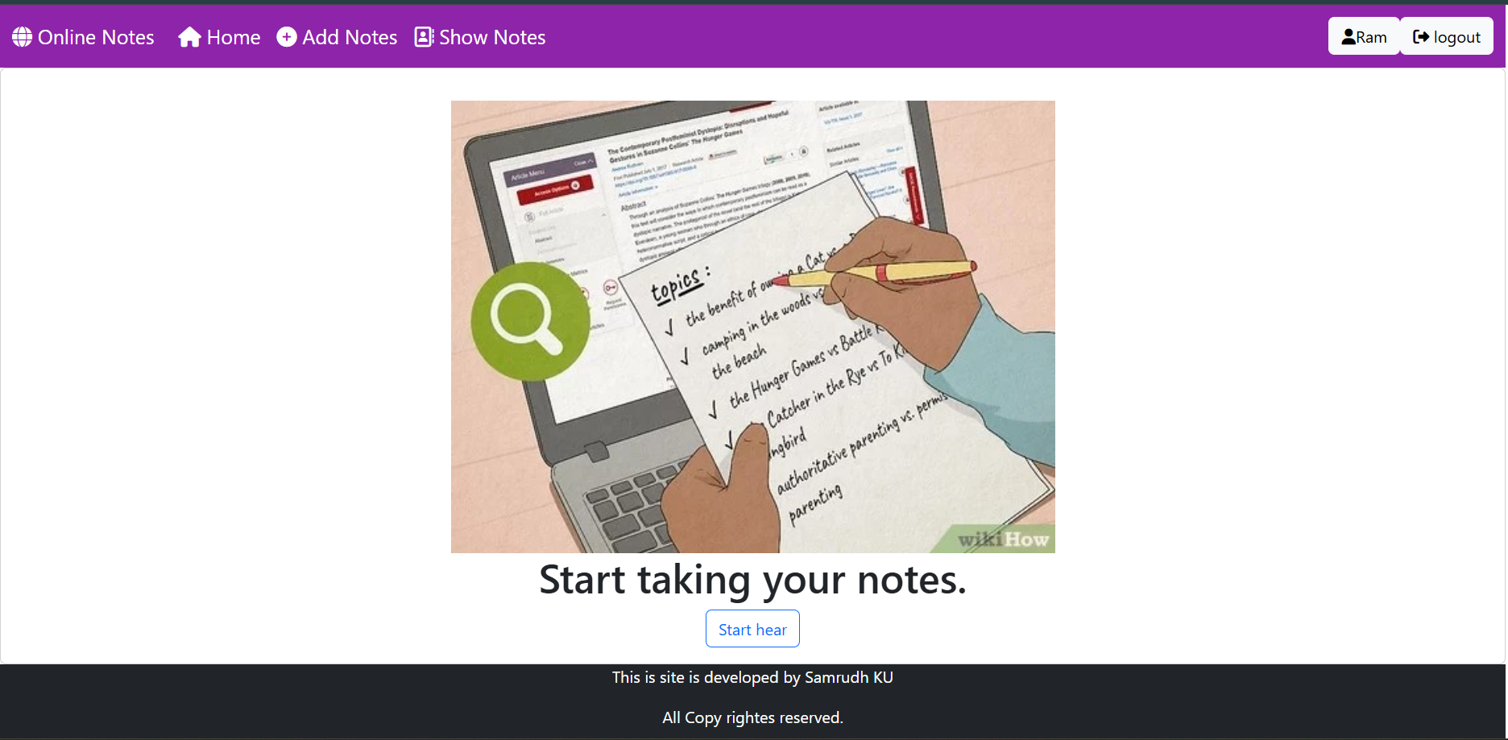
Home Page: Hear we can access the functionality of the Web Applications.

Slide 6
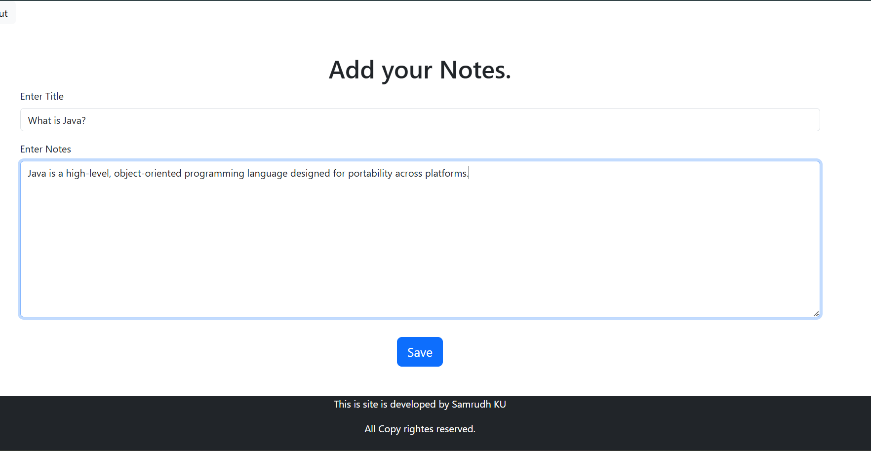
Add Notes Page: We can add our important notes hear.

Slide 7
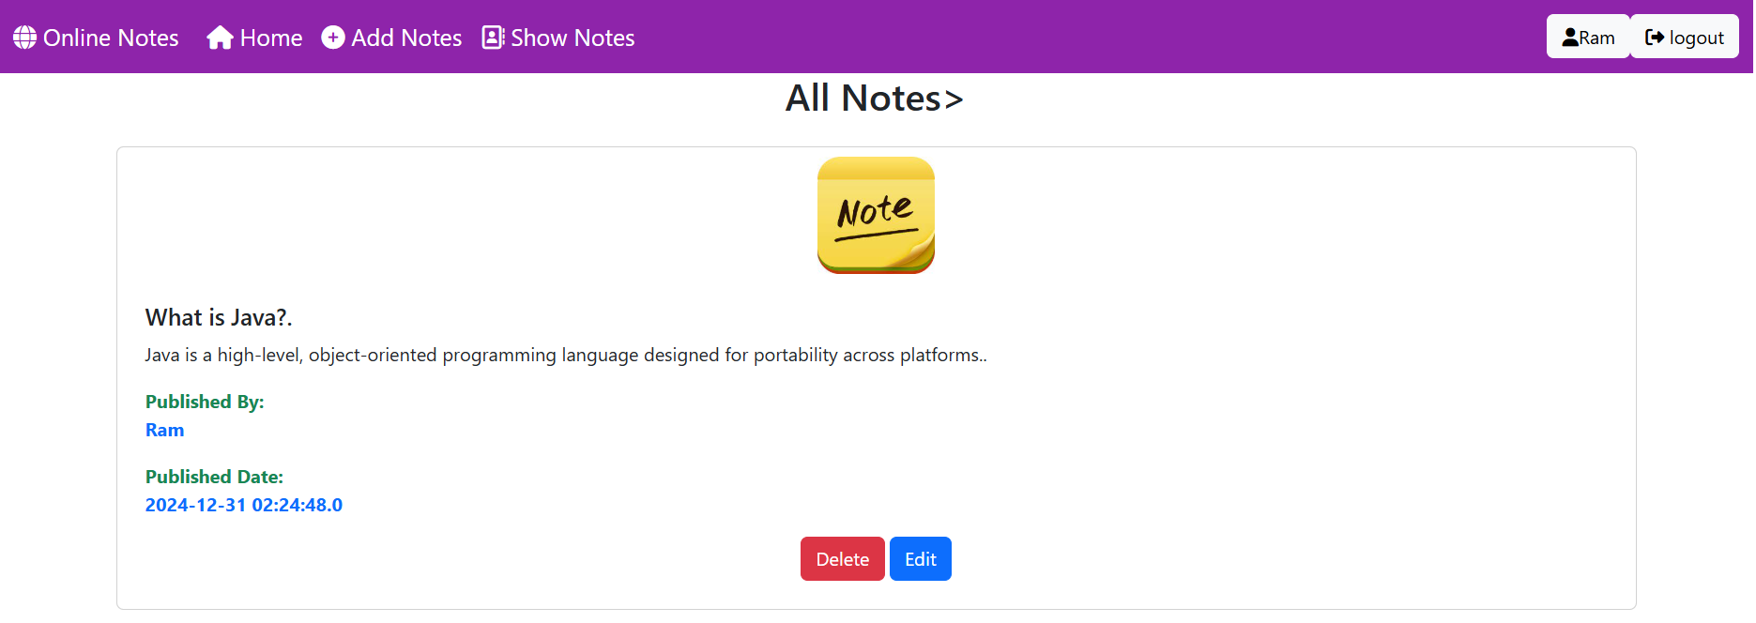
Show Notes Page: We can view all the added important notes and manage them by updating or deleting them.

